Slide 1
Education Inequality
by : Jason Rong

Slide 2

Problem
The purpose of this project is to determine whether school performance can be predicted by socioeconomic factors. We will be taking a look at the average performance of a students on the ACT.

Slide 3
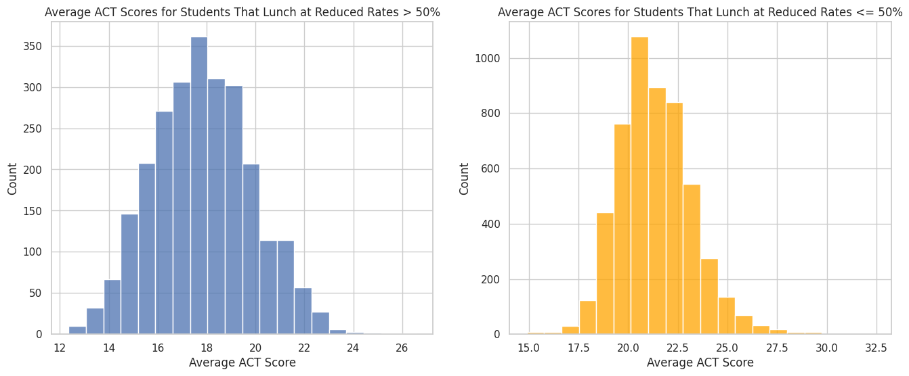
Effect of Free or Reduced Price Lunch
Notes:
We see that students who receive free or reduced price lunch do worse than students that don't receive free or reduced price lunch. This could be due to the fact that those students attend a more expensive school which also means their family may be wealthier than the others which could tie the two factors together.

Slide 4
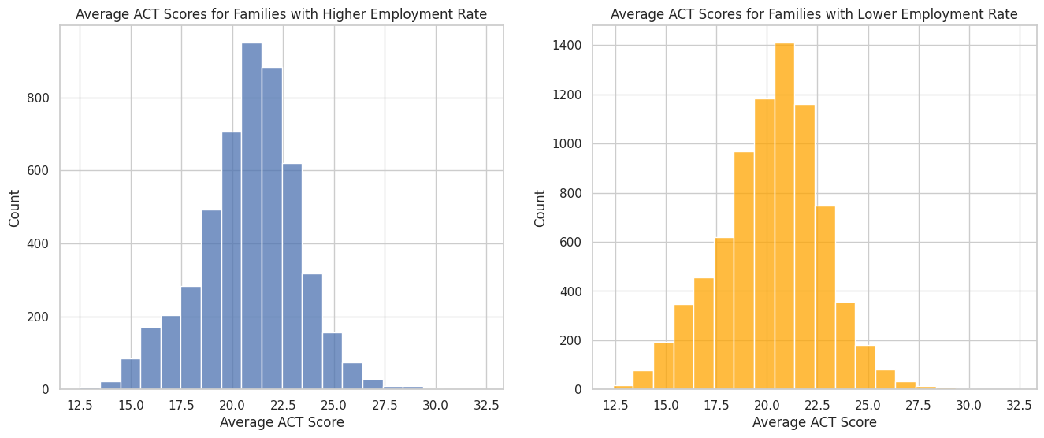
Effect of Unemployment Rates
Notes:
From a quick glance at this graph, it looks about even as to how unemployment rates affects ACT scores, but we do see around 22.5, the kids with employed parents tend to do better around that range. While it doesn't look like unemployment rates play that big of a part in affecting ACT scores, they still impact them to some degree.

Slide 5
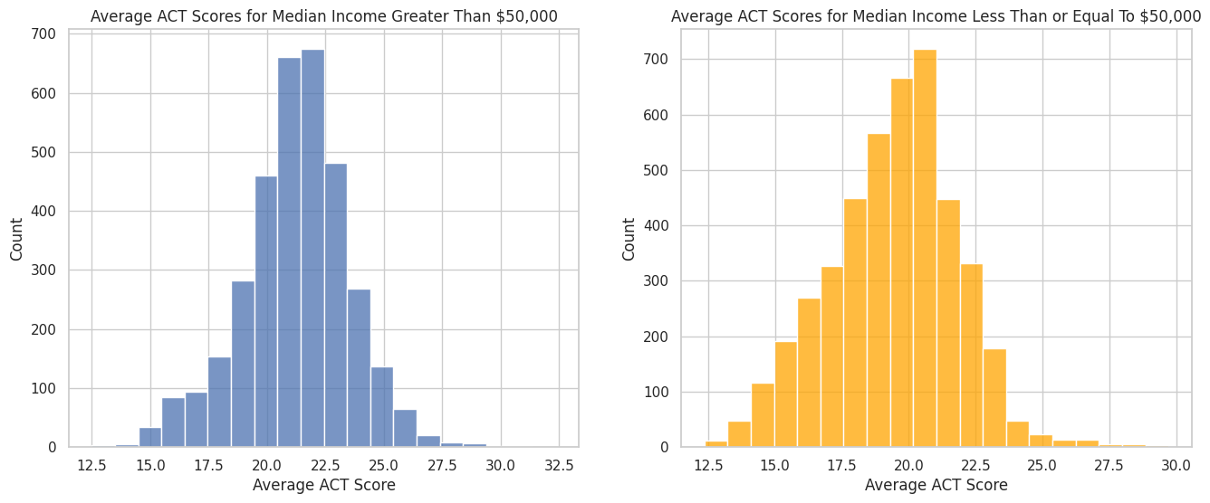
Effect of Income
Notes:
We can see between these two plots that households that make an average income of greater than $50000 perform have kids that perform better on the ACT. We see on the lower income side, there are more kids scoring lower than kids coming from a wealthier family. This is also proven on the higher end of the scores on the ACT. The kids coming from a wealthier family have a higher count in the higher ranges. Wealth could impact the kids because the kids might have to worry about other factors such as food or they may have to get jobs to also help support their families.

Slide 6
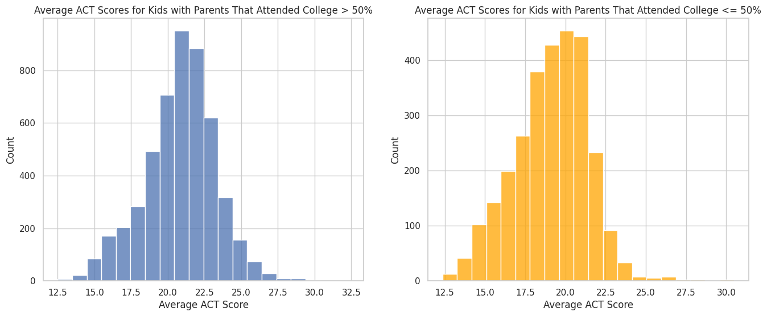
Effect of Parents That Attended College
Notes:
We see that kids with parents on the higher rate of attending college scores higher than kids with parents that didn't attend college. This could affect the kid's performance because the parents or parent could have helped to teach their kids some of the material covered on the ACT.

Slide 7
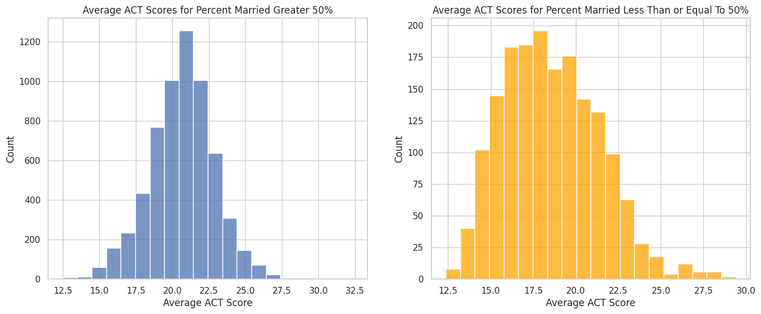
Effect of Marriage Rates
Notes:
We can see between these two plots, students with married parents perform significantly better on the ACT than kids without married parents. Judging from this graph, we are able to see that parents play a huge role in how well a child does on test.

Slide 8
Conclusion
Can’t predict the exact score one person will get
Can only make an estimate
There are so many factors at play that affects someone’s ACT score
However, if there is a large dataset of students, can predict an estimate of the distribution based on background
Notes:
From the graphs we made and the analysis discussed we can say that socioeconomic factors definitely play a role in how well a student does on the ACT. While we can't predict the exact ACT score a student would get, it can be assumed that students coming from a more fortunate background are more likely to do better on the ACT than students coming from a lesser fortunate background. There are so many factors at play that can increase a student's chances of doing good and bad some out of their control. In conclusion, we can predict how a student might do based on their background, but there is also no way for certain we can tell what a student would score as that differs from person to person because two students with the same background could produce two entirely different results. One might perform really well and the other might perform really bad. This could be due to how hard one of them studies compared to the other, so we can predict how someone could do based on their background or we can be entirely off. However, if we would have to assume based on a large set of students and how they would do, I believe we can predict the average ACT score on how they will do.

